Slide 1

VerteSegNet: A Deep Learning Approach to Automatic Vertebral Body Segmentation
Jiamin Zhou
Musculoskeletal Magnetic Resonance Imaging (Krug) Lab Department of Radiology, UCSF

Slide 2
U-Net for Image Segmentation
Training: 33 subjects (20% validation split)
Testing: 8 subjects
20 slices per subject
Ground truth: manual segmentation of L1-5 in 7 slices done by summer students
5 subjects without ground truth masks or 20 slices were excluded
4 input channels:
Water
Fat
R2*
Fat Fraction
Ronneberger et al. MICCAI 2015

Slide 3
Automatic Vertebrae Segmentation and Fat Quantification Pipeline
U-Net
output segmentation map (256x256x1)
ROI analysis and fat quantification
post-processing
Ronneberger et al. MICCAI 2015
input 4-channel slices (256x256x4)
feature extraction and upsampling using spatial information
manual segmentation map (256x256x1)

Slide 4
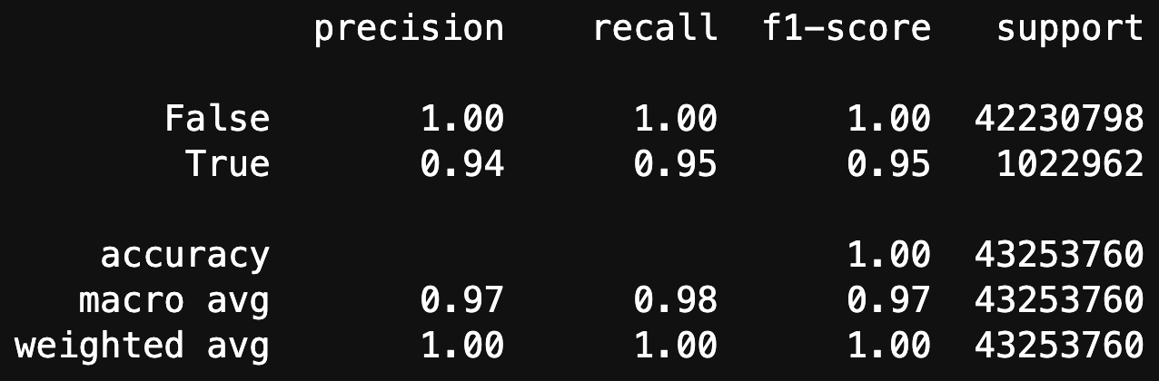
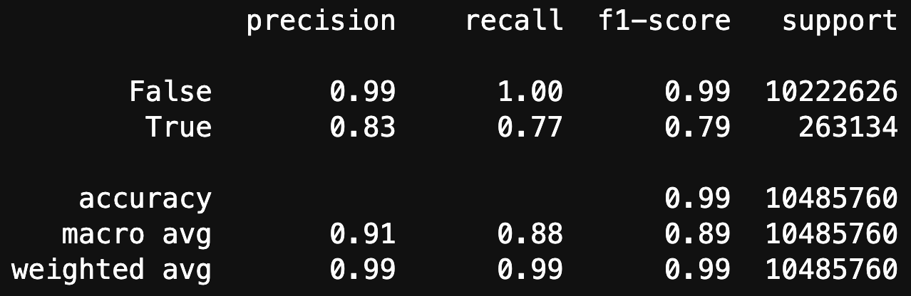

Training
Training Set
Epochs: ~300 (early stopping)
Adam optimization
Jaccard distance loss
Testing Set
Notes:
Precision-recall curves better than ROC for imbalanced datasets
Precision is the ratio tp / (tp + fp), ability of the classifier not to label as positive a sample that is negative.
Recall is the ratio tp / (tp + fn), ability of the classifier to find all the positive samples.
F1 score can be interpreted as a weighted average of the precision and recall.
macro-average will compute the metric independently for each class and then take the average (hence treating all classes equally)
vs weighted macro-average, in which each class contribution to the average is weighted by the relative number of examples available for it.

Slide 5
Training
Notes:
Precision-recall curves better than ROC for imbalanced datasets
Precision is the ratio tp / (tp + fp), ability of the classifier not to label as positive a sample that is negative.
Recall is the ratio tp / (tp + fn), ability of the classifier to find all the positive samples.
F1 score can be interpreted as a weighted average of the precision and recall.
macro-average will compute the metric independently for each class and then take the average (hence treating all classes equally)
vs weighted macro-average, in which each class contribution to the average is weighted by the relative number of examples available for it.

Slide 6
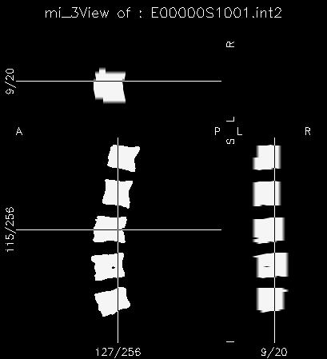
ROI Generation
Predicted masks saved as DICOMs
DICOM masks converted to .int2 format
MaskToMir from David Newitt’s programs written in IDL
ROIs corresponding to L1-5 were analyzed and compared with manual
ROIs for other vertebrae or not covering a significant portion of L1-5 were excluded

Slide 7
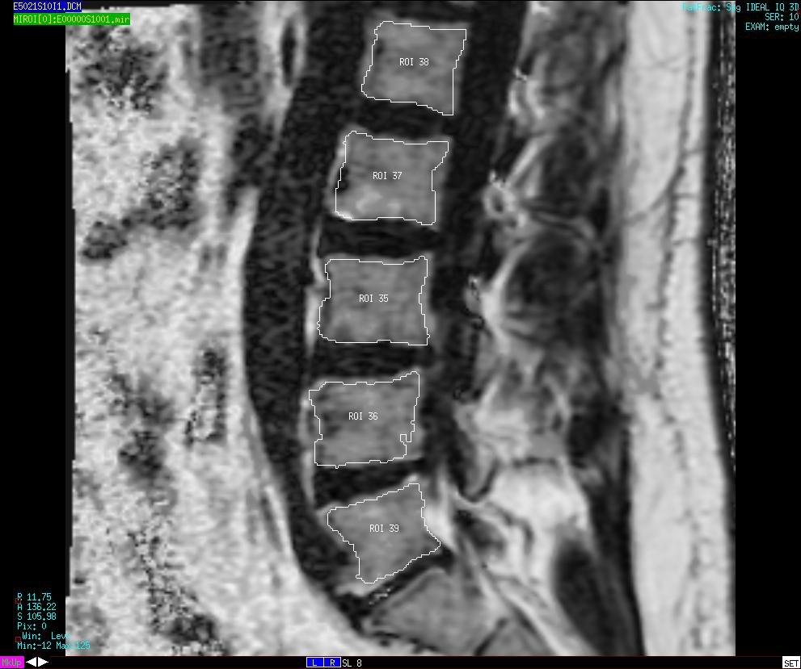

Slide 8
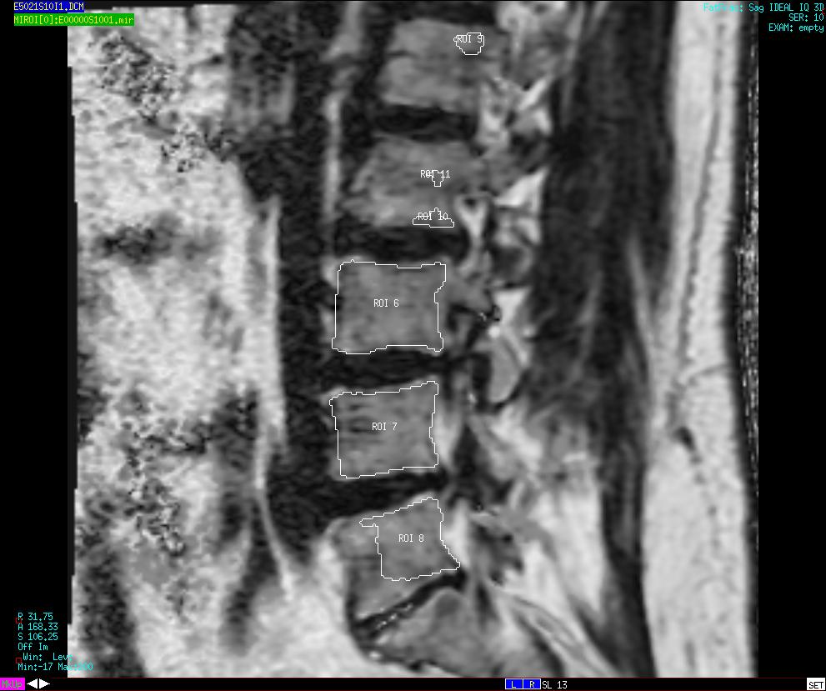

Slide 9
Stats
Calculate mean bone marrow fat fraction in each lumbar vertebral body for each subject
Bland-Altman analysis of mean BMF determined from manual vs. automatic segmentation

Slide 10
A
B

